Slide 1
Predicting the NCAA Basketball Tournament
By: Asher Erickson, Marius Nwobi, Aryan Sharma, Ryan Hanks

Slide 2
Question and Methodology
Research Question: “How well can we predict the 2021 March Madness Bracket?”
Methodology: Using datasets of March Madness from 2013-2019, we will use Logistic Regression to understand the most important statistics for winning March Madness games. In addition, we will use Support Vector Classification prediction to predict the 2021 March Madness Bracket.

Slide 3
Understanding SVMs
Support Vector Machines (SVMs) linearly separates data points, with a decision boundary line, whether the dataset itself is linear or not.
2D space divided by 1D line, 3D space divided by 2D plane
Then the SVM creates support vectors using the “closest” point(s) from each class on a graph to the decision boundary line.
Typically, the support vectors tend to be an upper and lower boundary line
The support vectors run parallel to the decision boundary line with a set margin (C value) in between the three lines (decision, upper, and lower).
A smaller C value (larger margin) leads to more misclassifications
A larger C value (smaller margin) leads to a better job of classifying data
Finally, we utilize GridSearchCV to figure out which combination of parameters (C, gamma, kernel) will return our best predictive results.

Slide 4
Original Dataset
Kaggle data set containing statistics from the 2013-2021 NCAA men's Division 1 basketball season
2020 season has no postseason data due to the coronavirus
Dataset contained 22 variables with 19 being basketball statistics
G, W, ADJOE, ADJDE, BARTHAG(power rating), EFG_O, EFG_D, TOR, TORD, ORB, DRB, FTR, FTRD, 2P_O, 2P_D, 3P_0, 3p_D, ADJ_T, WAB, Postseason, and seed, year
2454 teams in the data set
Datasets were separated by year

Slide 5
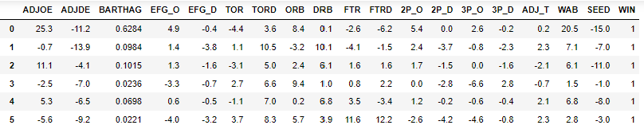
Data Manipulation
Dropped all teams that didn't make the NCAA tournament and columns: postseason, G, W, and CONF
Separated the datasets into two sub datasets with one containing the team with the better seed in a matchup, and the other dataset had matching rows with the respective opponent with the worse seed
Subtracted the better and worse seed datasets together in order to form a singular dataset that tracked results of the NCAA tournament and had the difference between each teams stats
Used the 2013-2019 data as our training dataset and used the 2021 data as our testing dataset

Slide 6
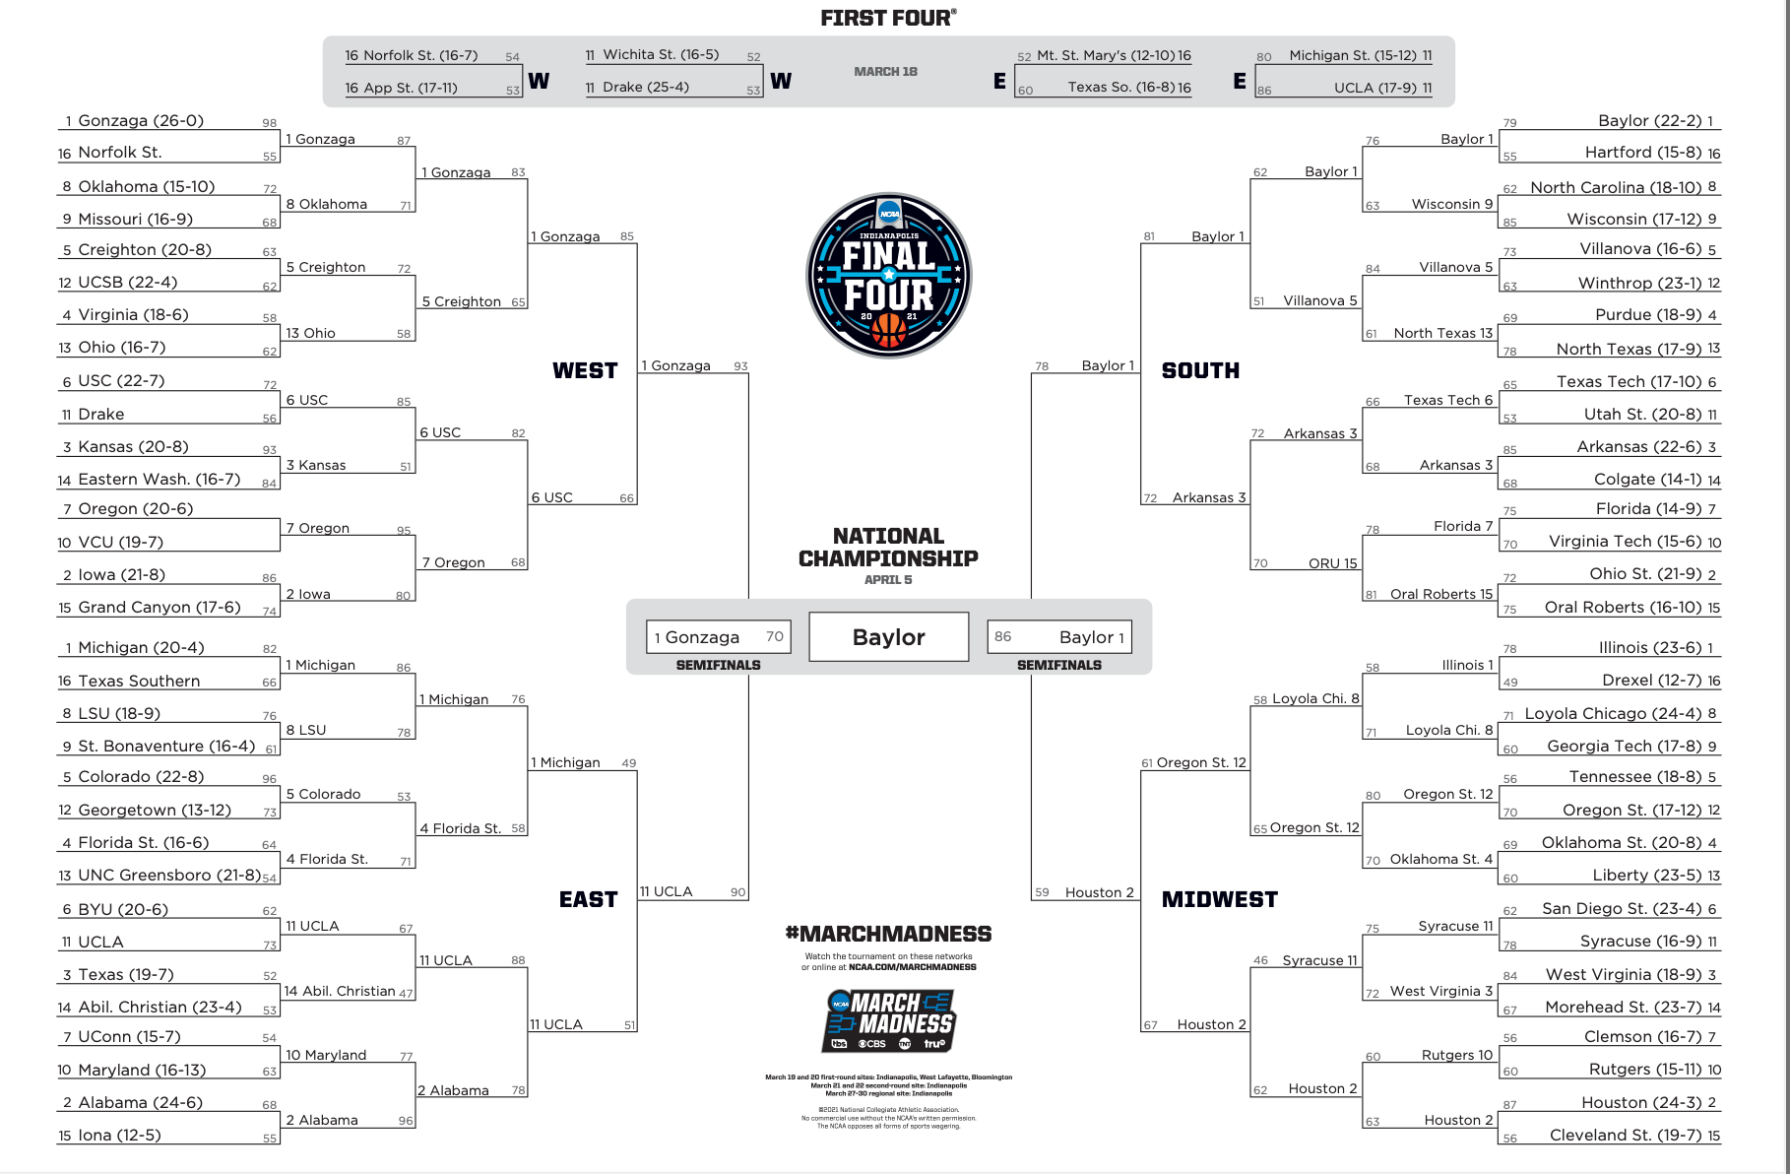

Slide 7
Results
Our SVC model correctly predicted approximately 73%, or 46 of the 63 games that took place in the 2021 March Madness Tournament.
In the real tournament there were 19 upsets, so if you were to select the better seeded team in each game, you would correctly predict 44 of the 63 games.
There is a slight pattern in our bracket prediction where there are a few teams with bad seeds that made a run in the tournament (which involved upsets in all of their games), but our prediction did not get these games correct.
The reasoning behind this is that humans are not always easy to predict, especially in sports. Basketball is a very streaky sport that involves a string of outcomes that are highly unlikely.
The explanation behind why certain NCAA teams make runs in March Madness cannot always be explained because there are many external factors at hand.
Sports Betting is a huge industry, and it thrives off the fact that sports are very difficult to predict.

Slide 8
Project Difficulties
Utilizing logistic regression in our project
Initially, we wanted to utilize logistic regression to evaluate which features of our 2013-19 March Madness data set were more impactful on whether a higher seed won their respective matchup or not.
However, we found that removing features with P values greater than 0.05 or trying a random combination of those features gave us a less accurate SVM model when predicting the 2021 bracket.
So in the end, we decided to not use logistic regression and trained our SVM model with all of our features included from the original 2013-19 data set.
Obtaining the data we needed to use
The way that we wanted to use our SVC required a specific set of data. The data that we found involved everything that we need, but the issue was that it was not organized in the way we wanted it.
There was not an easy way to organize the data, so we resorted to “brute forcing” the manipulation to the way we needed it. This did not take a super long time, but it was fairly tedious.

Slide 9
Thank you

